Slide 1
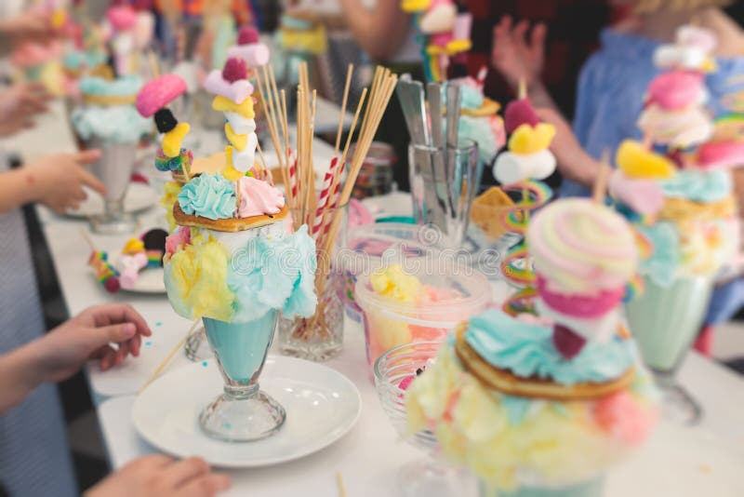
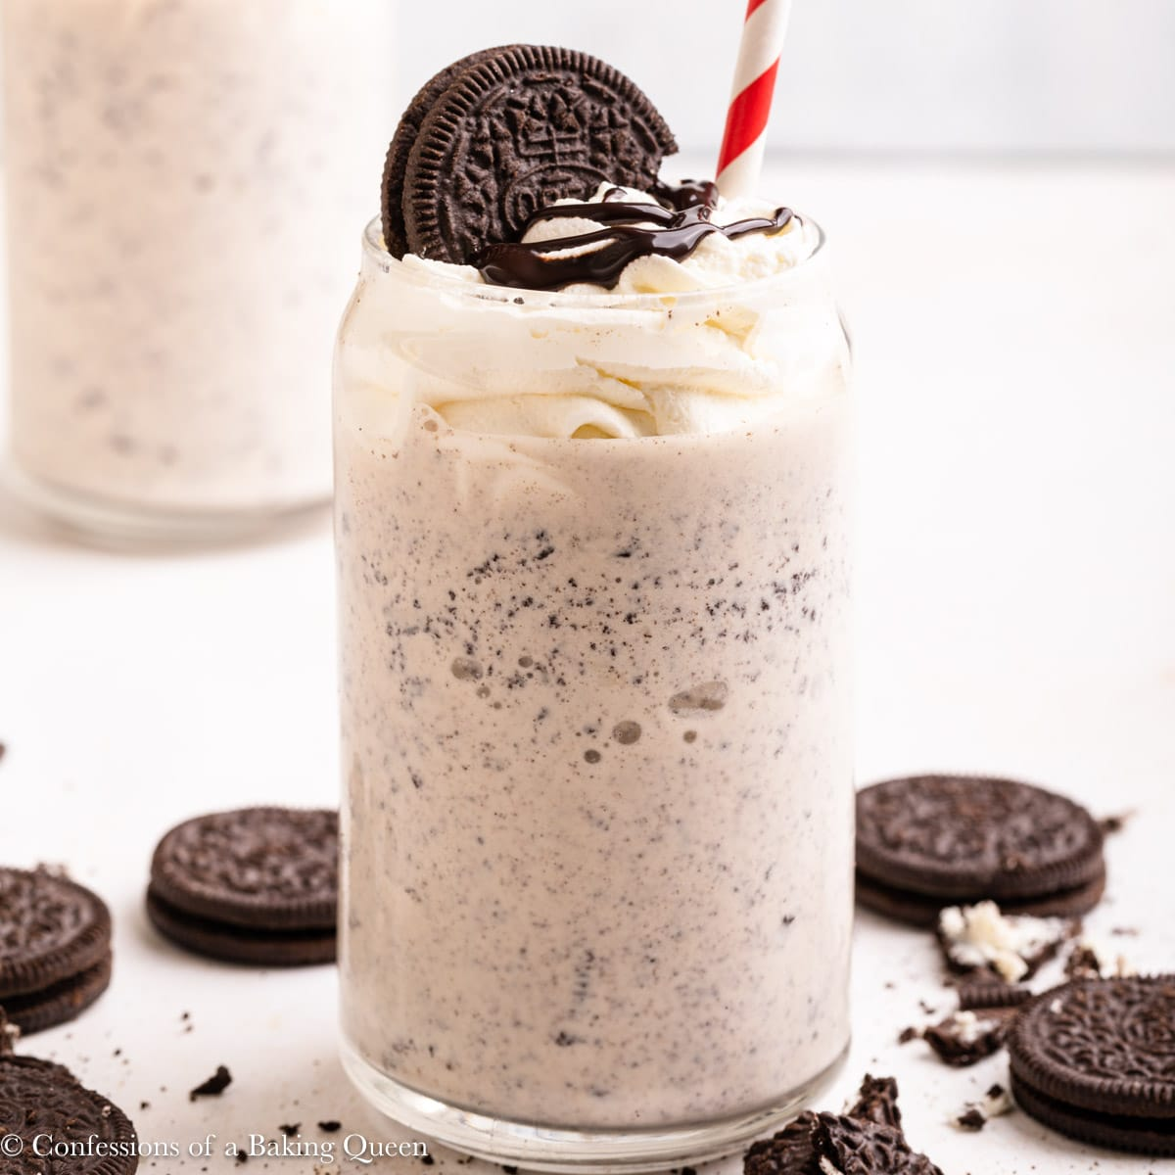
SHAKES AND SWEETS
SALE
For all orders over £25
SHOP
Oreo Shake
£5.98

Slide 2
SHAKES AND SWEETS
For all orders over £25
Oreo Shake
A throthy, creamy shake with crushed Oreo throughout, topped with whipped cream and an Oreo on top.
Oreo Shake – 5.98
Add To Cart

